Slide 1
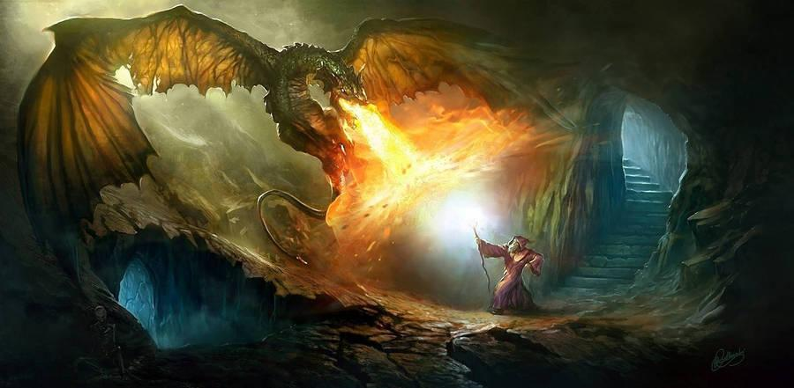

DnDBetter
By Gabe Lapham, Tyler Catuncan, Jonathan Clark, Seungwoo An, Zichen Fu, Triton & Cooper Sarphie

Slide 2
Project Description
Interactive, web-based Dungeons & Dragons character sheet
Easily created, edited, saved, and used during the user's own game sessions.
Quick and reliable way to reference your own characters stats without having to keep up with a piece of paper every time you want to play.

Slide 3
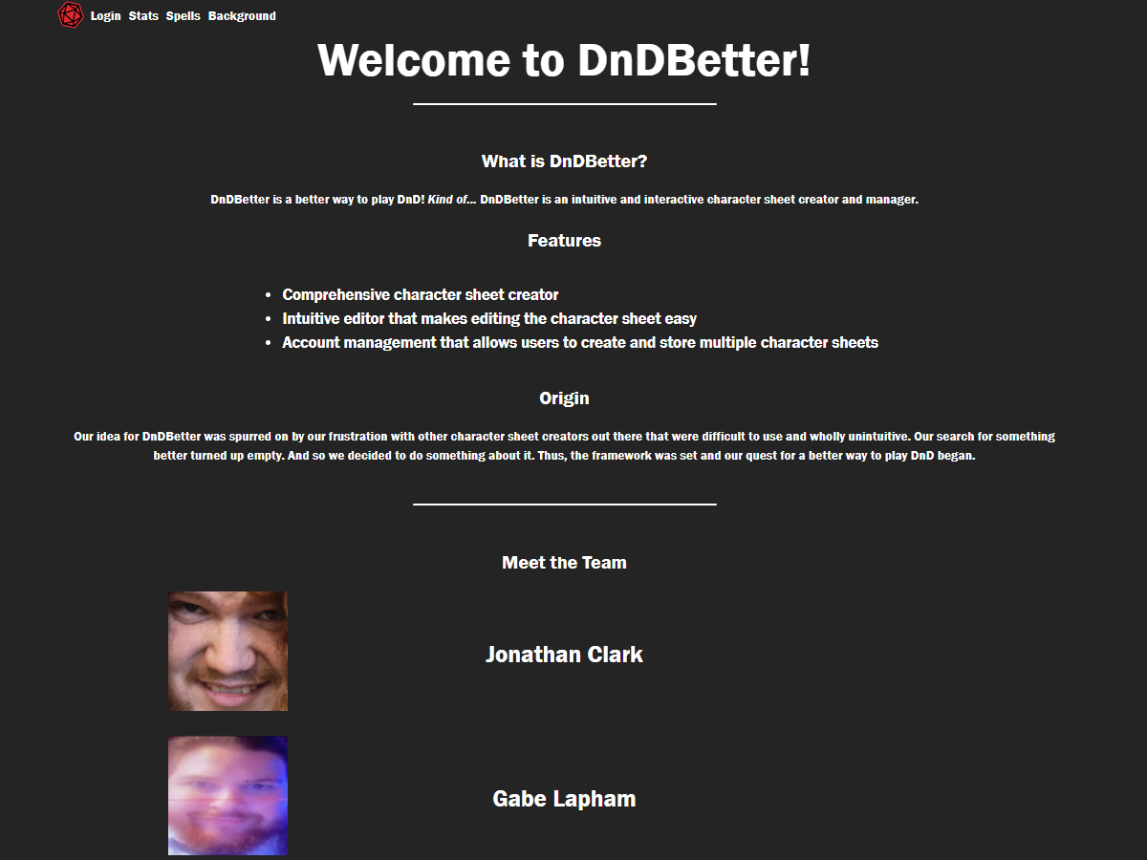
Landing Page
Brief description of the project
List of a handful of features
Images of the team

Slide 4
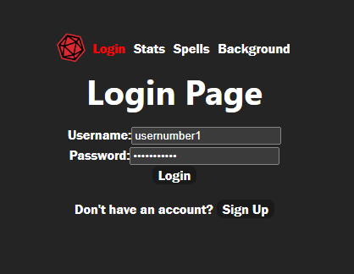
Account Log-in & Creation
Allows users to create accounts which are stored in the SQL database
Passwords are hashed for security
On other pages there will be a save button visible when logged in
This button will store the data that has been entered on the character sheet with the users authentication token to save their pages
Login state is checked for each page

Slide 5
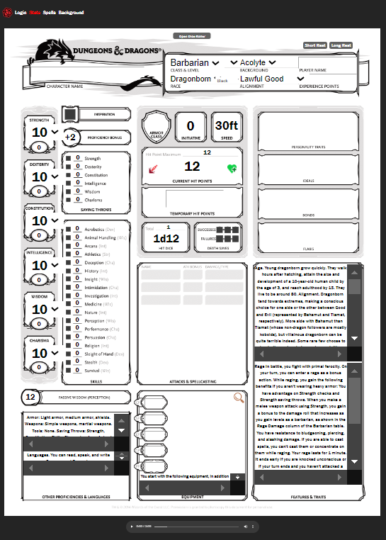
Character Statistics Page
Character Statistics are displayed, such as:
Class, Level, Race, Background, Alignment, Name, and EXP
Strength, Dexterity, Constitution, Intelligence, Wisdom, and Charisma
Saving Throws, Skills, and Passive Perception
Proficiencies and Languages
Equipment
Features & Traits
User-selected Attacks & Spellcasting
User-inputted Character Ideals
Hit Points, Hit Dice, Temporary Hit Points, and Death Saves
Armor Class, Initiative, and Speed

Slide 6
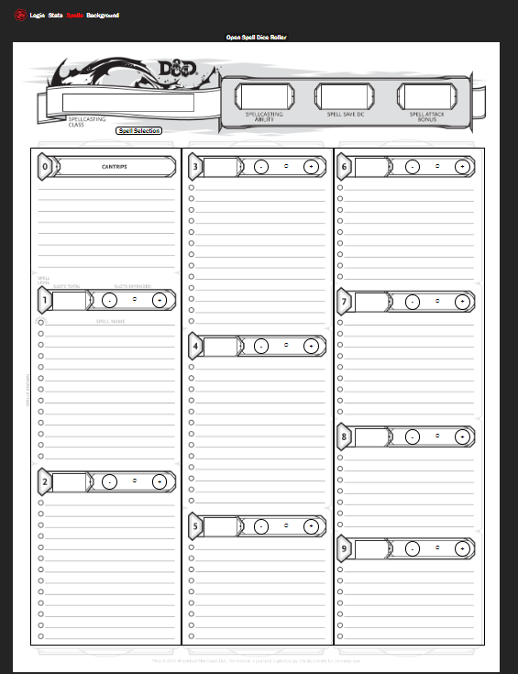
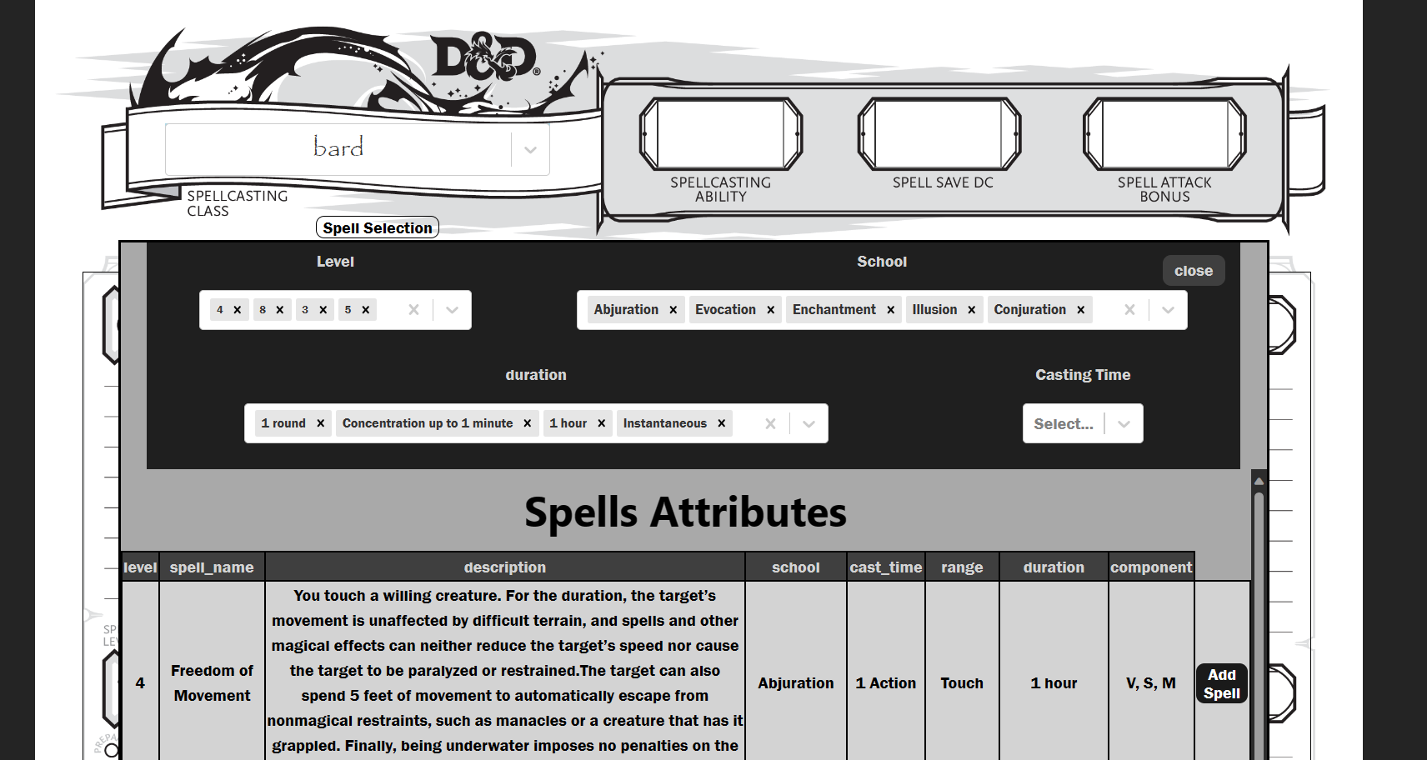
Character Spells Page
Spell class selection
Spell level category consists of slots and counter
Spell selection page with spell attributes and descriptions

Slide 7
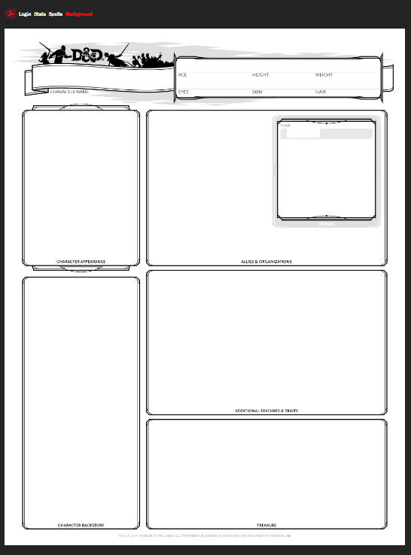
Character Background Page
Character background information
User name
User text input
User image input
Character appearance
Symbol image

Slide 8
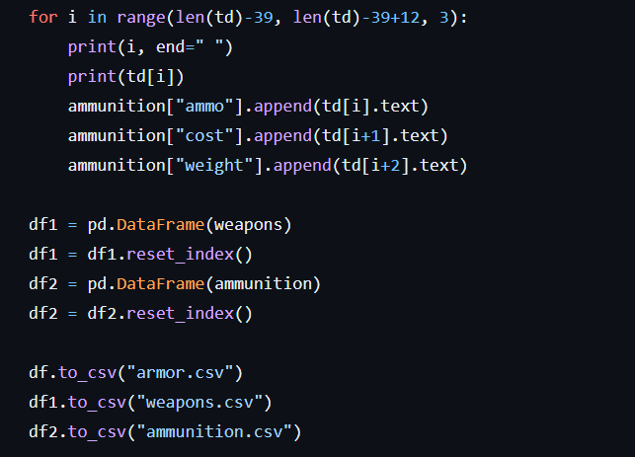
Scraping Info
Scraped information from wikidot 5e with BeautifulSoup
Stored information into Pandas dataframes
Converted Pandas dataframes into csv files
Imported csv files to MySQL database

Slide 9
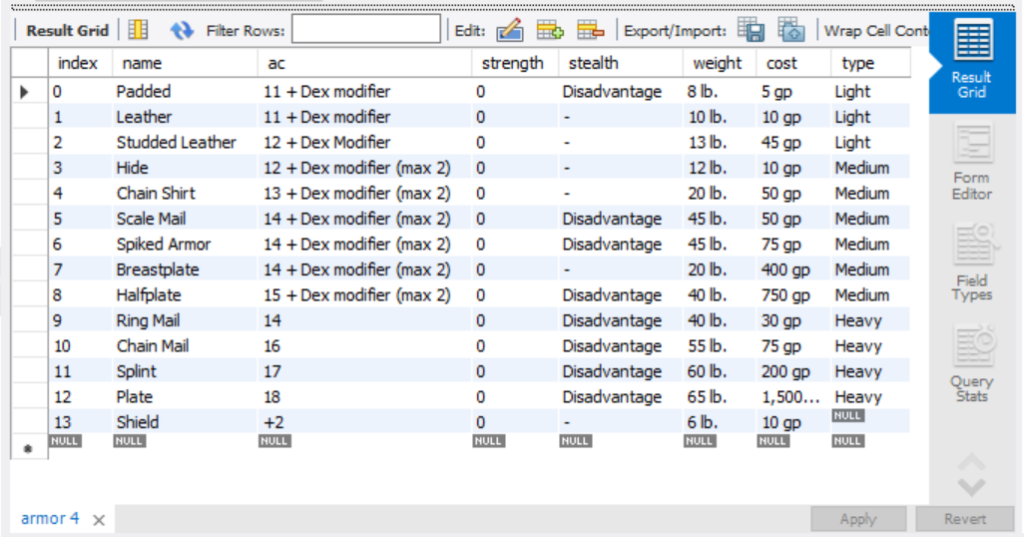
Scraping Info

Slide 10
What can be Improved?
Feedback system
Mobile version
Randomly generating the character
Importing / exporting the character

Slide 11
Demo Time

